Slide 1
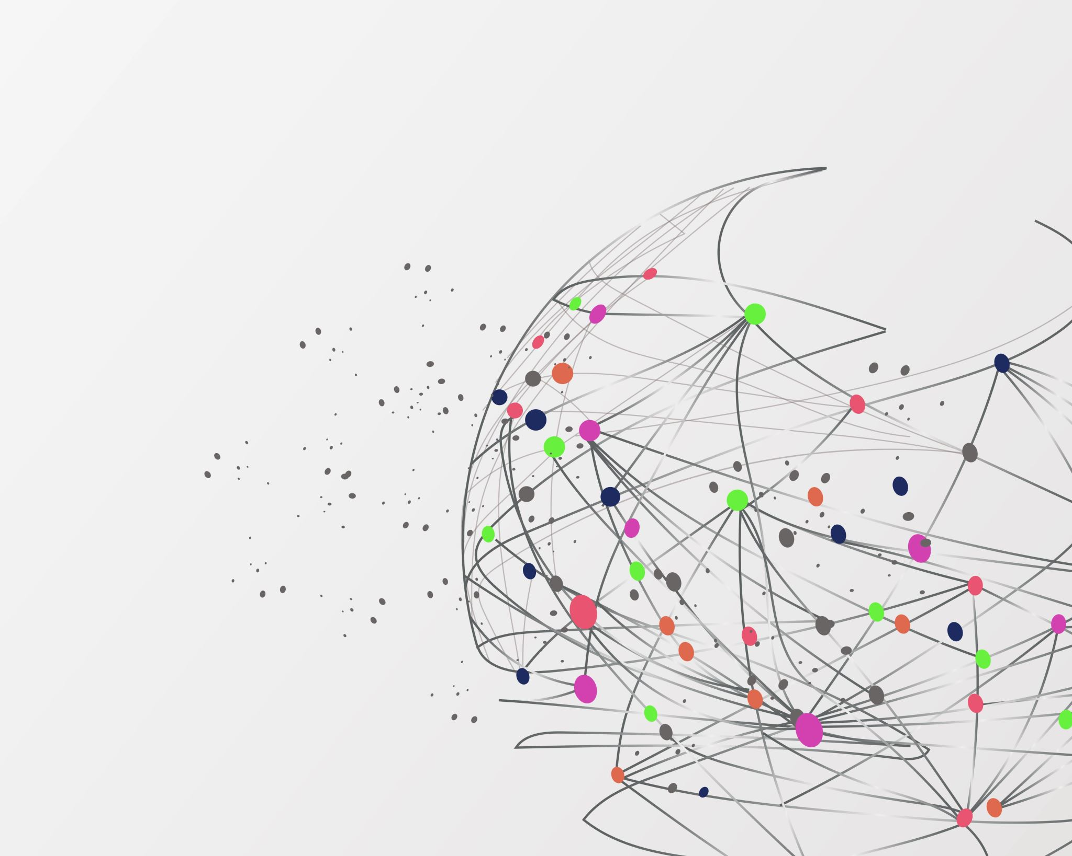

College Enrollees
College Enrollees at the State University of New York: A Study of Race Disparity

Slide 2
Objective
This project aims at studying racial and ethnic disparities in college enrollees base on student enrollments by race and ethnicity at the State University of New York.

Slide 3
Racial Disparity
What is it?
Racial inequality is typically defined as "imbalances” in the distribution of power, economic resources, and opportunities. Racial inequalities have manifested in American society in ways ranging from racial disparities in wealth, poverty rates, bankruptcy, housing patterns, educational opportunities, unemployment rates, and incarceration rates. Current racial inequalities in the U.S. have their roots in over 300 years of cultural, economic, physical, legal, and political discrimination based on race.

Slide 4
Racial Disparity (Cont.)
Healthcare
Criminal justice system
Proactive policing
Education
Housing
Jobs, etc…

Slide 5
Racial Disparity (Cont.)
Racial disparity in education is unequal distribution of academic resources, including but not limited to; school funding, qualified and experienced teachers, books, enrollment rate, and technologies to socially excluded communities.

Slide 6
Causes of Racial Disparity
Family of origin
Gender
Social class
Achievement
Earnings
Heath status
Political participation

Slide 7
Statistics
States Total population % of enrollees
Illinois 15% black/77 white 74.7% White, 9.77% Hispanic, 8.21% Black
Florida 16% black/77 white 52.6% White, 17.9% Hispanic, 5.97% Black
Georgia 12.5% Hispanics/ 12.3% Black /57.8 white 5.24% H, 8.39%, 67.7w

Slide 8
Methods
The dataset used for this project was obtained from data.gov. It is a collection that lists students that enrolled at the State University of New York beginning in fall 2002 that has been reported by the Vital Statistics Administration by categories of race and ethnicity. The collection provides data for students that enrolled at the State University of New York by race and ethnicity.

Slide 9
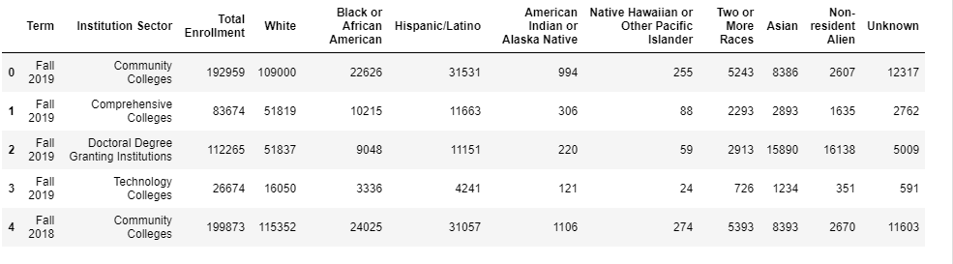
The Data + Target Variables

Slide 10
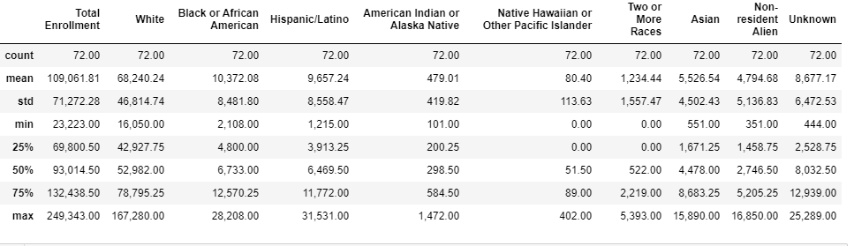
The Data + Target Variables (Cont.)

Slide 11
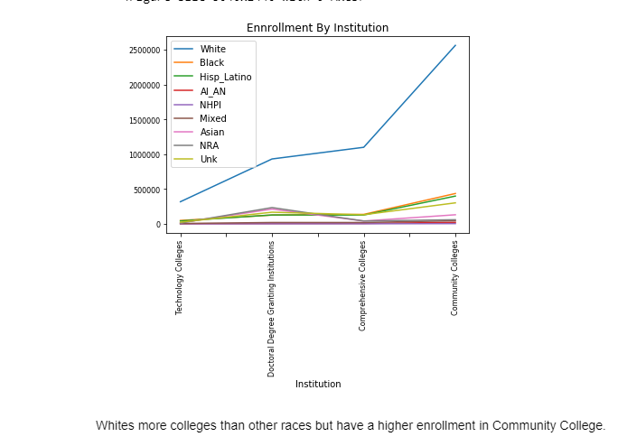
Results

Slide 12
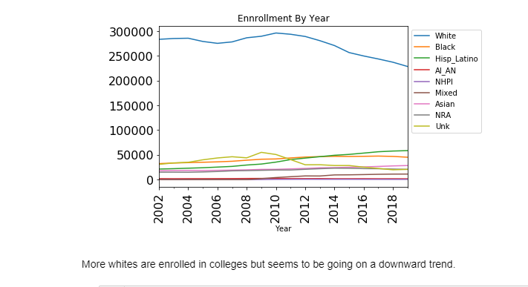
Results (Cont.)

Slide 13
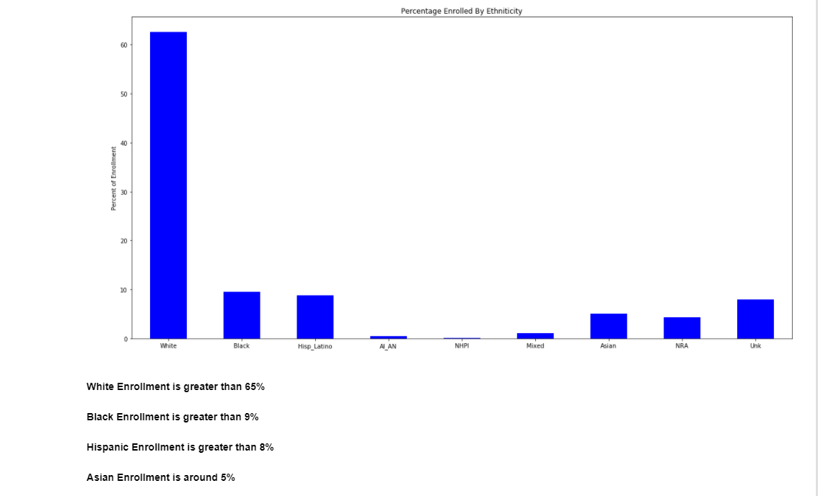
Results (Cont.)

Slide 14
Code
GitHub
https://cherf001.github.io/Frenel-Cherubin/

Slide 15
References
1.Janai C. Raphael, G, Bill DeBaun: Enrollment and Completion Outcomes by Race/ Ethnicity and Gender- National College Access Network, June 2019
https://cdn.ymaws.com/www.ncan.org/resource/resmgr/publications/ncan_benchmarking_outcomes_b.pdf
2.Lorelle L. Espinosa, Jonathan M. Turk, Morgan Taylor, Hollie M. Chessman: Race and Ethnicity in Higher Education: A Status Report- American Council on Education
https://www.luminafoundation.org/wp-content/uploads/2019/03/race-and-ethnicity-in-higher-ed.pdf
3.Mary J. Fischer: Settling into Campus Life: Differences by Race/Ethnicity in College Involvement and Outcomes- Taylor & Francis, Ltd.
https://www.jstor.org/stable/4501200?seq=1
4.Tomás Monarrez, Kelia Washington: Racial and Ethnic Representation in Postsecondary Education, June 18, 2020
https://www.urban.org/research/publication/racial-and-ethnic-representation-postsecondary-education
5.Center for Education Policy Analysis: Racial and Ethnic Achievement Gaps
https://cepa.stanford.edu/educational-opportunity-monitoring-project/achievement-gaps/race/

Slide 16
References (Cont.)
6.Data USA: University of Florida
https://datausa.io/profile/university/university-of-florida#:~:text=The%20enrolled%20student%20population%20at,American%20Indian%20or%20Alaska%20Native
7.National Center for Education Statistics: College Enrollment Rates
https://nces.ed.gov/programs/coe/pdf/coe_cpb.pdf
8.U.S. Department of Education: Advancing Diversity and Inclusion in Higher Education, November 2016
https://www2.ed.gov/rschstat/research/pubs/advancing-diversity-inclusion.pdf
9.Wikipedia-The Free Encyclopedia: Demographics of Florida, February 1, 2021
https://en.wikipedia.org/wiki/Demographics_of_Florida#:~:text=According%20to%20the%202018%20US,from%20two%20or%20more%20races
10.Wikipedia-The Free Encyclopedia: Demographics of California, March 31, 2008
https://en.wikipedia.org/wiki/Demographics_of_California#:~:text=According%20to%202018%20US%20Census,from%20two%20or%20more%20races.

